Slide 1
Data Science
CSE-4075
(K-Nearest Neighbor)

Slide 2
If you want to annoy your neighbors, tell the truth about them.
Pietro Aretino

Slide 3
Different Learning Methods
Eager Learning
Explicit description of target function on the whole training set
Instance-based Learning
Learning=storing all training instances
Classification=assigning target function to a new instance
Referred to as “Lazy” learning

Slide 4
Eager Learning
Any random movement
=>It’s a mouse
I saw a mouse!

Slide 5
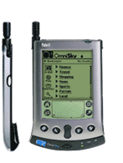
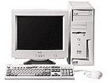
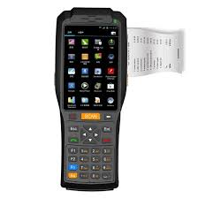
Instance-based Learning
Its very similar to a
Desktop!!

Slide 6
Instance based learning
Approximating real valued or discrete-valued target functions
Learning in this algorithm consists of storing the presented training data
When a new query instance is encountered, a set of similar related instances is retrieved from memory and used to classify the new query instance

Slide 7
Disadvantage of instance-based methods is that the costs of classifying new instances can be high
Nearly all computation takes place at classification time rather than learning time

Slide 8
K-Nearest Neighbor algorithm
Most basic instance-based method
Data are represented in a vector space
Supervised learning

Slide 9
WHY NEAREST NEIGHBOR?
Used to classify objects based on closest training examples in the feature space
Feature space: raw data transformed into sample vectors of fixed length using feature extraction (Training Data)
Top 10 Data Mining Algorithm
ICDM paper – December 2007
Among the simplest of all Data Mining Algorithms
Classification Method
Implementation of lazy learner
All computation deferred until classification
?
9

Slide 10
K NEAREST NEIGHBOR
Requires 3 things:
Feature Space(Training Data)
Distance metric
to compute distance between records
The value of k
the number of nearest neighbors to retrieve from which to get majority class
To classify an unknown record:
Compute distance to other training records
Identify k nearest neighbors
Use class labels of nearest neighbors to determine the class label of unknown record
?
10
6

Slide 11
Feature space

Slide 12
K NEAREST NEIGHBOR
k = 1:
Belongs to square class
k = 3:
Belongs to triangle class
?
k = 7:
Belongs to square class
Choosing the value of k:
If k is too small, sensitive to noise points
If k is too large, neighborhood may include points from other classes
Choose an odd value for k, to eliminate ties
8
12
ICDM: Top Ten Data Mining Algorithms k nearest neighbor classification December 2006

Slide 13
In nearest-neighbor learning the target function may be either discrete-valued or real valued
Learning a discrete valued function
, V is the finite set {v₁,......,v_{n}}
For discrete-valued, the k-NN returns the most common value among the k training examples nearest to xq.

Slide 14
Training algorithm
For each training example <x,f(x)> add the example to the list
Classification algorithm
Given a query instance x_{q} to be classified
Let x₁,..,x_{k} k instances which are nearest to x_{q}
Where δ(a,b)=1 if a=b, else δ(a,b)= 0 (Kronecker function)

Slide 15
Definition of Voronoi diagram
the decision surface induced by 1-NN for a typical set of training examples.
_
.
_
_
.
+
_
.
+
.
.
_
xq
+
_
.
+

Slide 16
kNN rule leads to partition of the space into cells (Vornoi cells) enclosing the training points labelled as belonging to the same class
The decision boundary in a Vornoi tessellation of the feature space resembles the surface of a crystall

Slide 17
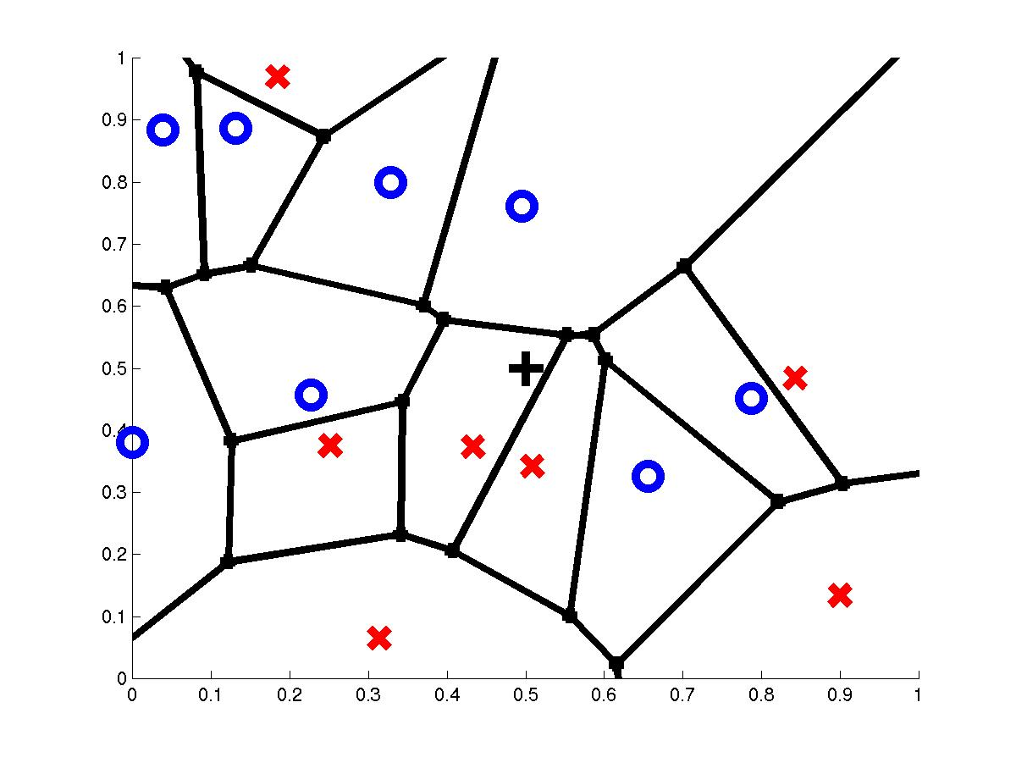
1-Nearest Neighbor
query point q_{f}
nearest neighbor q_{i}

Slide 18
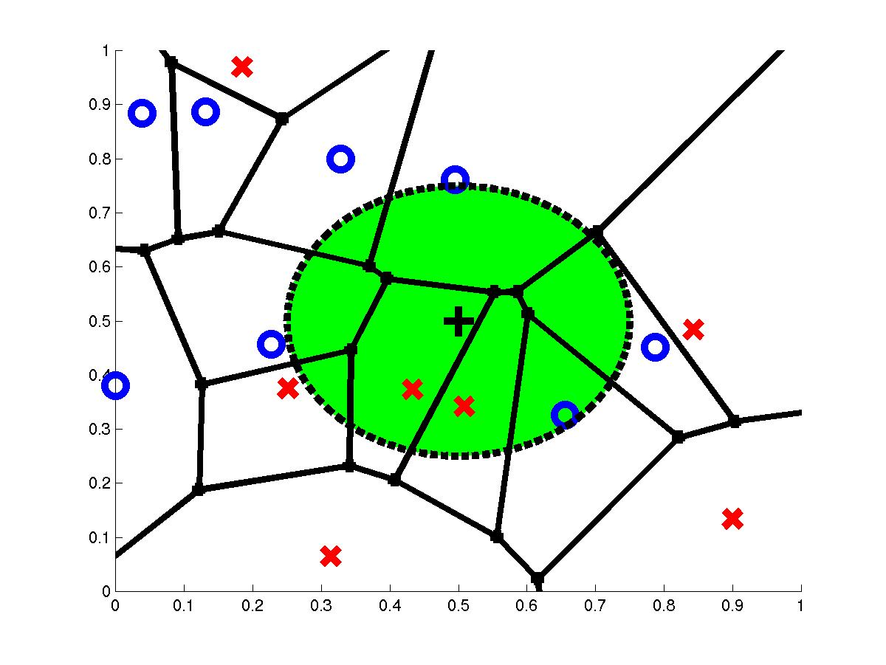
3-Nearest Neighbors
query point q_{f}
3 nearest neighbors
2x,1o

Slide 19
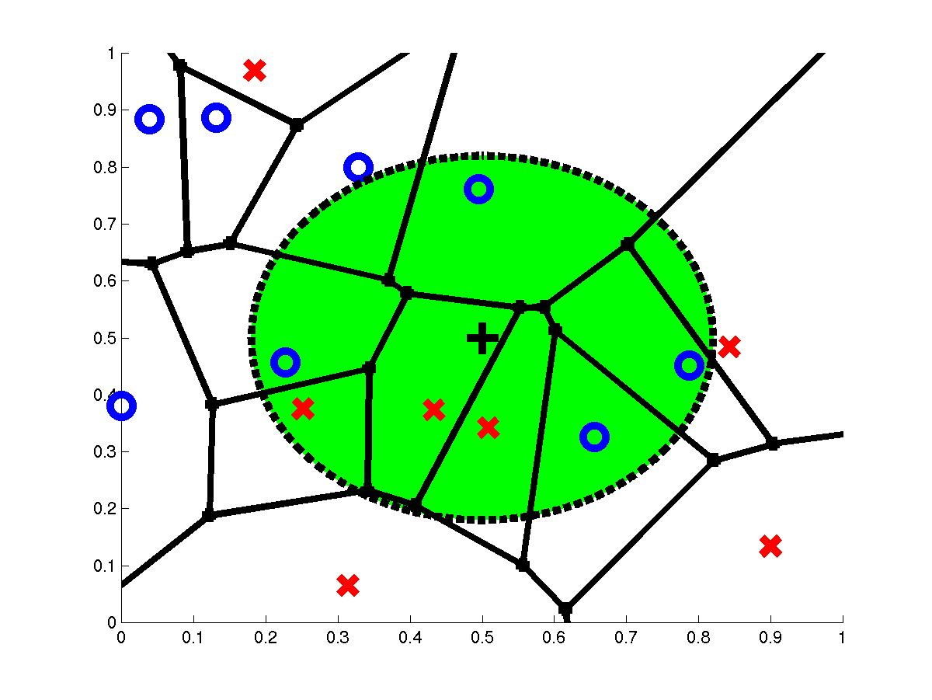
7-Nearest Neighbors
query point q_{f}
7 nearest neighbors
3x,4o

Slide 20
How to determine the good value for k?
Determined experimentally
Start with k=1 and use a test set to validate the error rate of the classifier
Repeat with k=k+2
Choose the value of k for which the error rate is minimum
Note: k should be odd number to avoid ties

Slide 21
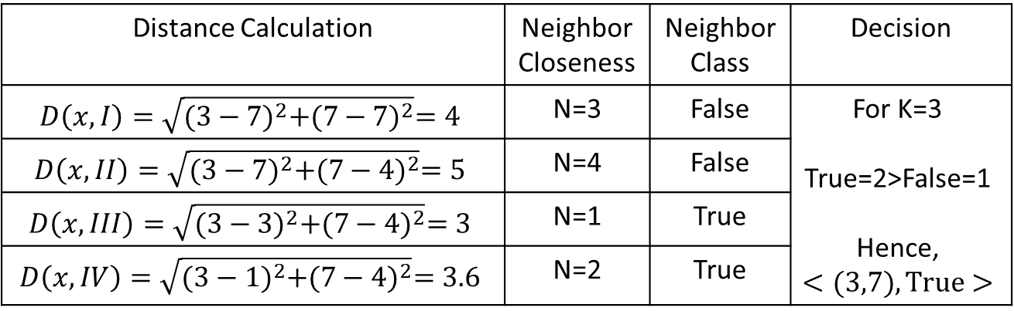

Training Data
(I)
(II)
(III)
(IV)
Testing Instance
$$\left\{<(3,7),?>\right\}$$
Parameters:
Distance Metric= Euclidean Distance
Nearest Neighbors =K= 3
Distance Calculation | Neighbor Closeness | Neighbor Class | Decision
$$D\left(x, I\right)=\sqrt{{(3−7)}^{2}+{(7−7)}^{2}}=4$$ | N=3 | False | For K=3 True=2>False=1 Hence, $$<(3,7),True>$$
$$D\left(x, II\right)=\sqrt{{(3−7)}^{2}+{(7−4)}^{2}}=5$$ | N=4 | False
$$D\left(x, III\right)=\sqrt{{(3−3)}^{2}+{(7−4)}^{2}}=3$$ | N=1 | True
$$D\left(x, IV\right)=\sqrt{{(3−1)}^{2}+{(7−4)}^{2}}=3.6$$ | N=2 | True

Slide 22
Continuous-valued target functions
kNN approximating continous-valued target functions
Calculate the mean value of the k nearest training examples rather than calculate their most common value

Slide 23
Distance Weighted
Refinement to kNN is to weight the contribution of each k neighbor according to the distance to the query point x_{q}
Greater weight to closer neighbors
For discrete target functions

Slide 24
Distance Weighted
For real valued functions

Slide 25
Curse of Dimensionality
Imagine instances described by 20 features (attributes) but only 3 are relevant to target function
Curse of dimensionality: nearest neighbor is easily misled when instance space is high-dimensional
Dominated by large number of irrelevant features
Possible solutions
Stretch j-th axis by weight z_{j}, where z₁,…,z_{n} chosen to minimize prediction error (weight different features differently)
Use cross-validation to automatically choose weights z₁,…,z_{n}
Note setting z_{j} to zero eliminates this dimension alltogether (feature subset selection)
PCA

Slide 26
When to Consider Nearest Neighbors
Instances map to points in R^{d}
Less than 20 features (attributes) per instance, typically normalized
Lots of training data
Advantages:
Training is very fast
Learn complex target functions
Do not loose information
Disadvantages:
Slow at query time
Presorting and indexing training samples into search trees reduces time
Easily fooled by irrelevant features (attributes)

